Slide 1
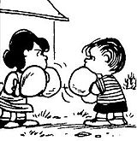
EDA for Boxing Matches Dataset

Slide 2
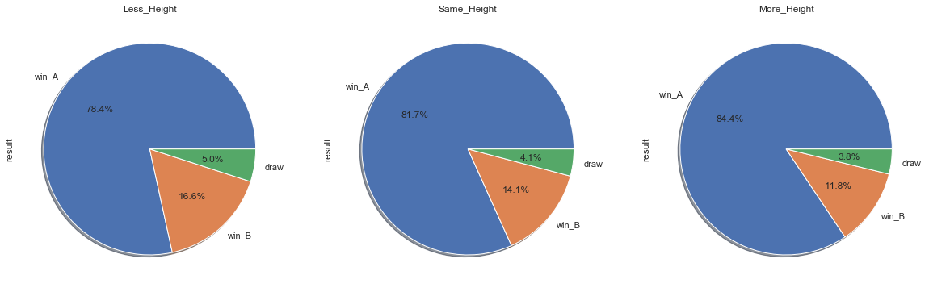
How Height difference affects the outcome of the match?

Slide 3
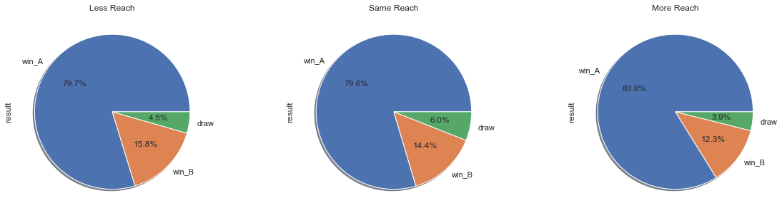
How Reach difference affects the outcome of the match?

Slide 4
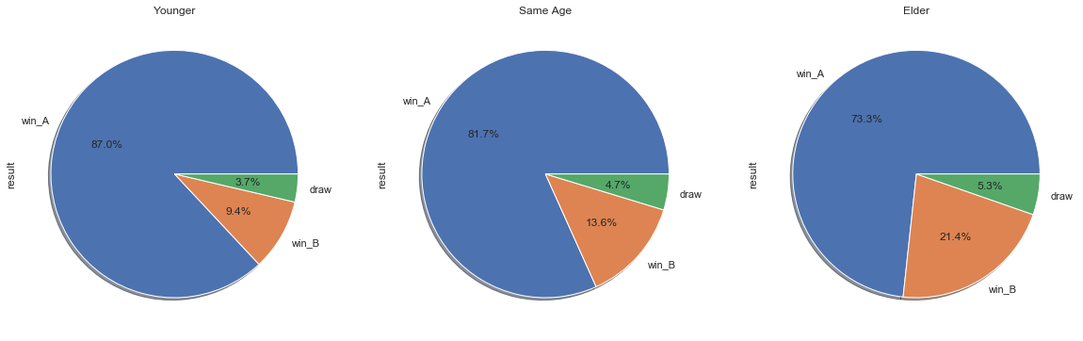
How Age difference affects the outcome of the match?

Slide 5
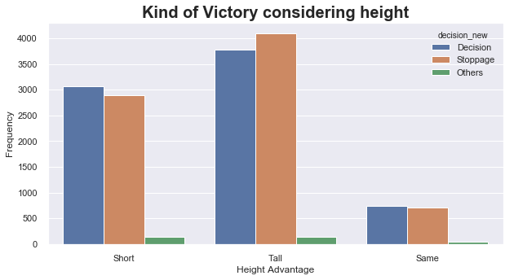
Does height helps the boxers to win more dominantly?

Slide 6
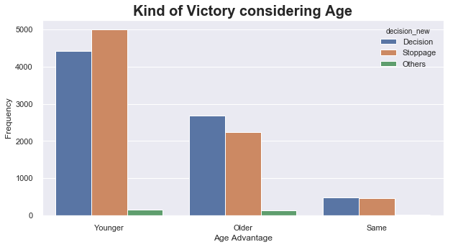
Does Age helps the boxers to win more dominantly?

Slide 7
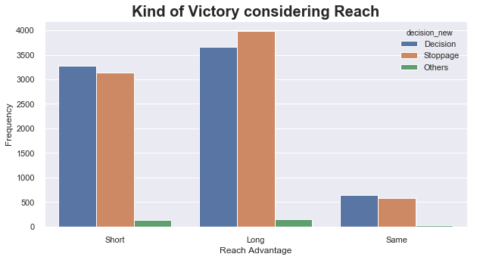
Does reach helps the boxers to win more dominantly?

Slide 8
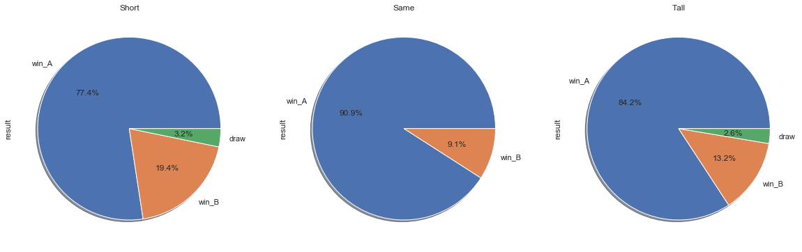
How advantage in single physical attribute(Height) fare with the outcome of the boxers?

Slide 9
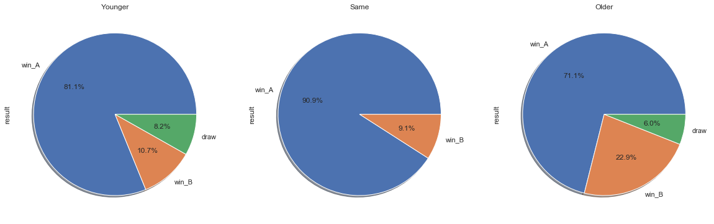
How advantage in single physical attribute(Age) fare with the outcome of the boxers?

Slide 10
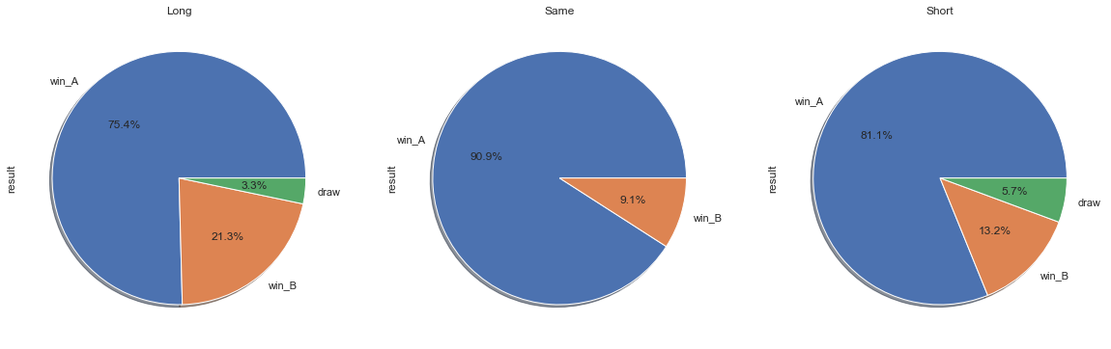
How advantage in single physical attribute(reach) fare with the outcome of the boxers?

Slide 11
Conclusion
We see that boxers with better physical attributes have better chance of winning the bout
Age and Height Specially play a crucial role in deciding the outcome of the fight
Range also plays a crucial role in deciding the outcome, but not as effective as the other two, as Range didn’t perform well when we set other parameters/attributes as same.
We are aware that stance plays a crucial role as well, but the data we had only had details of boxers fighter with other boxers with similar stance
We also noticed that boxers with better physical attributes also win the fight more dominantly.
The dataset provided had more winners as Boxer A. Hence we saw more than 50% winning percentage in either case. However it doesn’t affect our analysis.

Slide 12
Thank You !!

